Slide 1
MMA 801 – Introduction to Management Session One – In-Class Assignment 3 Business Model Analysis: Spotify
Master of Management in Analytics May 14, 2020 Stirling Team

Slide 2
Spotify’s business model
Value proposition to listeners:
Freemium model
Easy to use and access
Expanding to Podcast which competes with radio
One stop access to all things audio entertainment
Value proposition to advertisers:
Access to vast user base
Value proposition to music industry
Legal music stream across jurisdictions, helped music industry fight piracy

Slide 3
Revenue model and customer base conversion
What drives revenue?
Growth of Premium Subscriber / ad supported users
Conversion from free to premium users
Ad revenue
Are there any underlying weaknesses associated with this current model? If so, what are they?
Easily replicated; Retain users from competition
Market penetration may hit limit
Annoy customers if push too hard
What about the shift to podcasts and video streaming? Are Spotify’s conclusions relating to the synergy of podcasts to customer stickiness correct? Does this product line expansion offer broad market growth appeal? Is this the right direction to go?
One stop access to all audio entertainment
Video side should stick to music video, etc. may derail the music focus if into shows
Such expansions had not resulted in users, need more data to explore

Slide 4
Cost structure
What concerns you the most?
85% of revenue goes to music industry
Popularity of musicians may make them indispensable
R&D is more defensive due to competition and security concerns
The direct listing decision did not tackle the problematic growth in financing costs
How much control does the company actually have over its cost base?
Negotiation power against music industry: weak (long struggle to lower a few ppts)
However piracy may provide a moat, so music industry cannot be too grabby

Slide 5
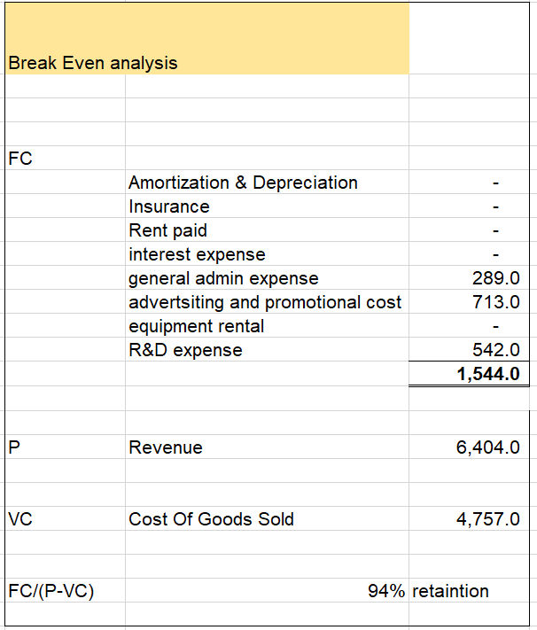
Breakeven
Given its current, improved cost structure, can you offer a rough estimate of the level of scale required for Spotify to move to Y/Y breakeven?
A rough breakeven analysis showed that Spotify had to maintain 94% of its users

Slide 6
Recommendations
in terms of strategic prioritization and resource allocation, which you believe would further assist in correcting the underlying weaknesses in its business model and strengthen the company’s profitability potential. Comment on your conclusions relating to its Podcast prioritization as part of this recommendation focus.
Tiered subscription model to increase conversion rate from ad-supported to premium subscriber
Continue to diversify its offerings to audio entertainment
Data analytics to further understand their users, focus on recommendations
Selling some of the recommendation slots to musicians
Produce music in the long-tail - Spotify Originals, even sign up musicians
Monetize search history data, to ad industry and music industry alike
Full use of advertising capacity

Slide 7
is Spotify over-valued and over-exposed?
With growth expected to slow over the upcoming years, and with Apple, Google, and Amazon’s renewed focus in this market segment, is Spotify over-valued and over-exposed? “Market Cap” valuation has dropped by just under 30% (now $25.8B), as share price, currently at $138.94 per share (on April 15, 2020), is down from its five-year high of $196 per share. Will your recommendations enable Spotify to hold and improve its current “market Cap”?
Overvalued still, but our plan will fix it.
Decline in share price due to decline in avg user revenue
Thin margins makes low resilience in tough market, over priced
It is a growth stock in a low growth environment
Their expansion in other markets likely to be hindered by local champions

